Slide 1
Optimizing sales and Forecasting Future Growth:Strategy for Underperforming Mall
Njeri Jadline
February,2024

Slide 2
Agenda
In this presentation I will be sharing my findings in regards to the sales of clothes in different shopping malls .
My primary focus will be on the most underperforming mall and data-driven strategies that can aid in improving the sales of this mall.

Slide 3
Introduction
I’ll be presenting insights that have emerged from detailed examination of sales data with a focus on the underperforming mall
The objective is not only to uncover the sales trends but also to come up with strategies to boost the sales of ths specific mall

Slide 4
Current State Analysis
The mean average price of clothes in the various shopping malls is the same .Showing that there is parity and uniformity in the prices of clothes in the 8 shopping malls
Using seaborn’s distplot,i was able to observe that the prices were periodic.This indicates that there were regular fluctuation of prices of clothes in the various malls.

Slide 5
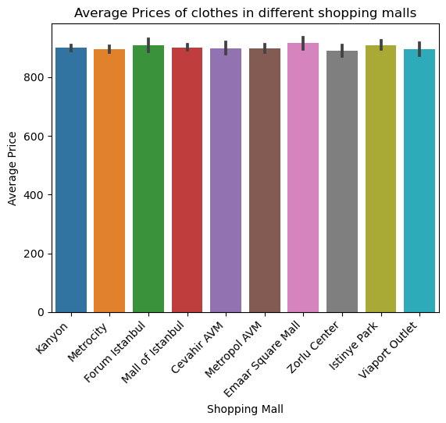

Slide 6
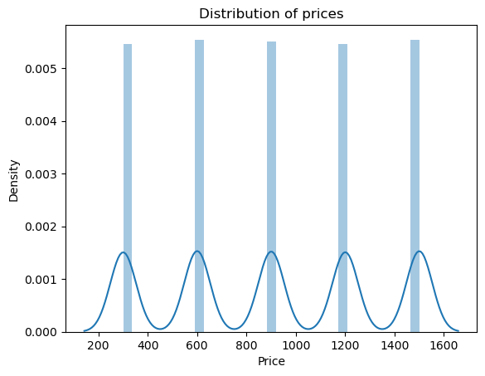

Slide 7
Overview of the shopping Malls
We have 8 shopping malls under analysis:
Cevahir AVM,
Emaar Square Mall,
Forum Istanbul
Istinye Park
Kanyon
Mall of Istanbul
Metrocity
Metropol AVM
Viaport Outlet
Zorlu Center

Slide 8
Sales Performance overview
Although the average prices of clothes across this shopping malls is approximately the same,there are notable differences in the sales performance
Emaar square mall made the least sales compared to the mall of istanbul which had the highest performance.

Slide 9
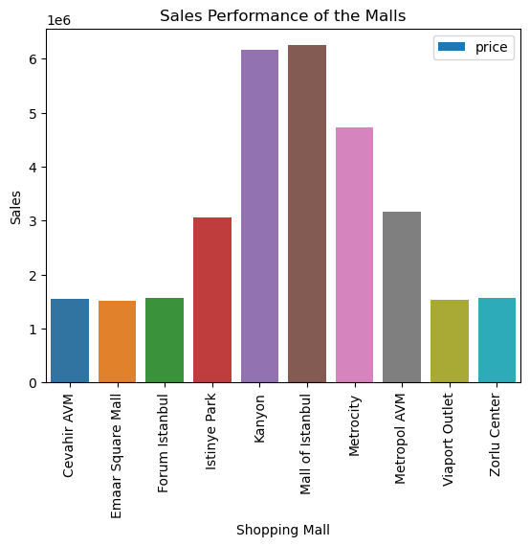

Slide 10
Underperforming Mall
Emaar Square Mall turned out to be the mall with the least amount of sales made in the 3years.
One of the insights were that,this mall had least amount of quantity of clothes ,which might have been one of the contributors of the low sales.

Slide 11
Underperforming malls
Further insights
The primary contributors to Emaar Square mall’s revenue were women emphasizing the need to tailor marketing strategies.
The predominant age group among the customers was 38years old.This gives us the chance to explore what they like to buy and how they prefer to shop.
Upon grouping the data by year,it was notable that the sales in 2022 outspaced those in 2023 .
Majority of the customers opted for cash as the means of payment as compared to other methods of payment like debit and credit cards
The month of January stood as out as the peak sales month for Emaar Square

Slide 12
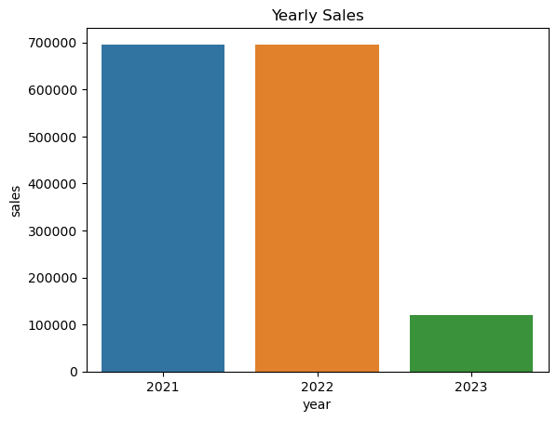

Slide 13
Recommendations
Conduct thorough competitor analysis to identify areas of improvements.
Expand payment options to accommodate various customer preferences
Implement data driven strategies for impactful improvements.
Tailor campaigns to resonate with the female customer base

